Slide 1
Chapter 10
Error Detection and Correction
Types of Errors
Detection
Correction

Slide 2
Basic concepts
Networks must be able to transfer data from one device to another with complete accuracy.
Data can be corrupted during transmission.
For reliable communication, errors must be detected and corrected.
Error detection and correction are implemented either at the data link layer or the transport layer of the OSI model.

Slide 3
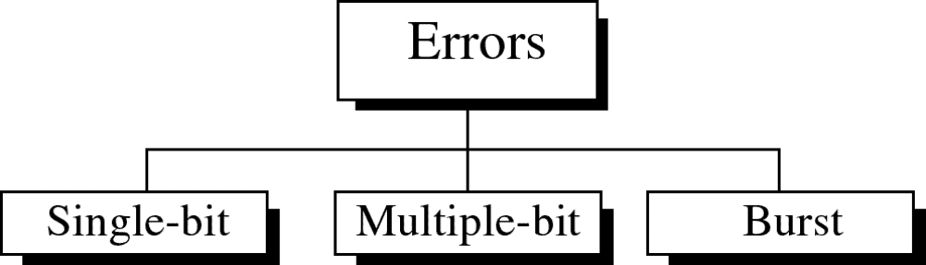
Types of Errors

Slide 4
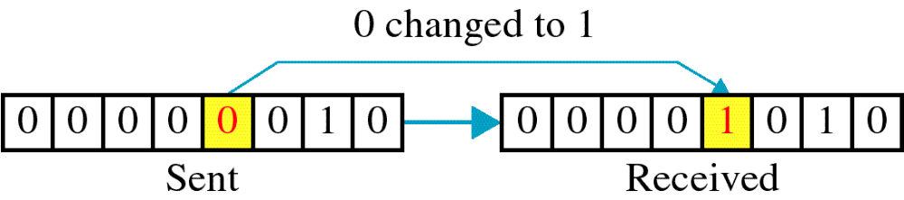
Single-bit error

Slide 5
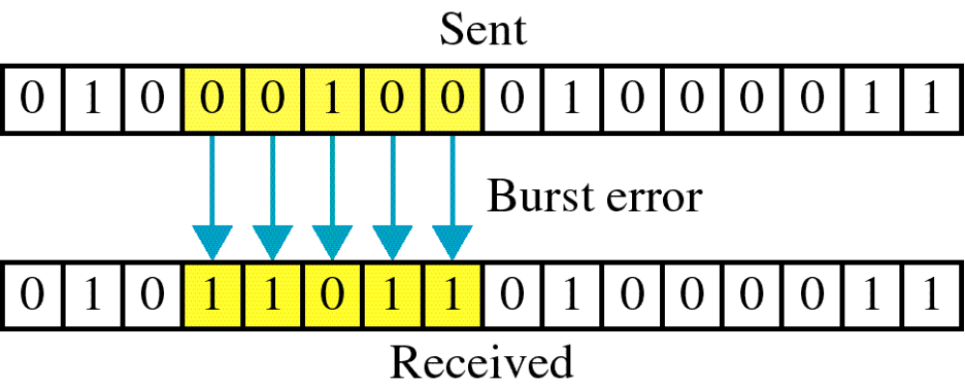
Burst error

Slide 6
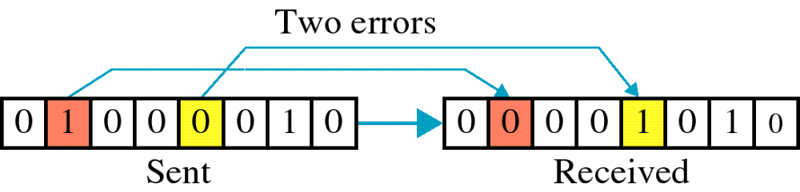

Slide 7
The term burst error means that two or more bits in the data unit have changed from 1 to 0 or from 0 to 1.
Burst errors does not necessarily mean that the errors occur in consecutive bits, the length of the burst is measured from the first corrupted bit to the last corrupted bit..

Slide 8
Error detection
Error detection means to decide whether the received data is correct or not without having a copy of the original message.
Error detection uses the concept of redundancy, which means adding extra bits for detecting errors at the destination.
Notes:
Make sense of message.
Make sense of message.

Slide 9
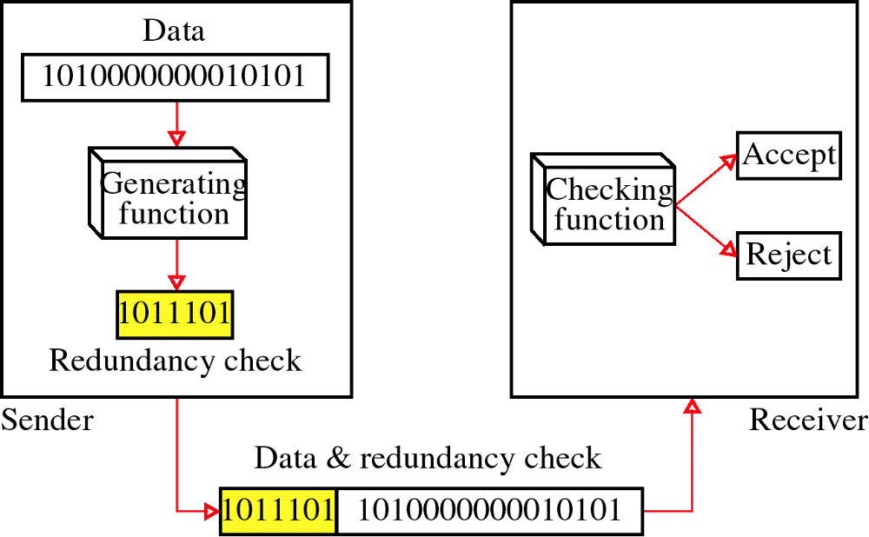
Redundancy

Slide 10

Note
The Hamming distance between two words is the number of differences between corresponding bits.
10.

Slide 11

Example 10.4
Let us find the Hamming distance between two pairs of words.
1. The Hamming distance d(000, 011) is 2 because
2. The Hamming distance d(10101, 11110) is 3 because
10.

Slide 12
Note
The minimum Hamming distance is the smallest Hamming distance between
all possible pairs in a set of words.
10.

Slide 13
Example 10.5
Find the minimum Hamming distance of the coding scheme in Table 10.1.
Solution
We first find all Hamming distances.
The d_{min} in this case is 2.
10.

Slide 14
Example 10.6
Find the minimum Hamming distance of the coding scheme in Table 10.2.
Solution
We first find all the Hamming distances.
The d_{min} in this case is 3.
10.

Slide 15
10-3 LINEAR BLOCK CODES
Almost all block codes used today belong to a subset called linear block codes. A linear block code is a code in which the exclusive OR (addition modulo-2) of two valid codewords creates another valid codeword.
Topics discussed in this section:
Minimum Distance for Linear Block Codes
Some Linear Block Codes
10.

Slide 16
Note
In a linear block code, the exclusive OR (XOR) of any two valid codewords creates another valid codeword.
10.

Slide 17


Slide 18
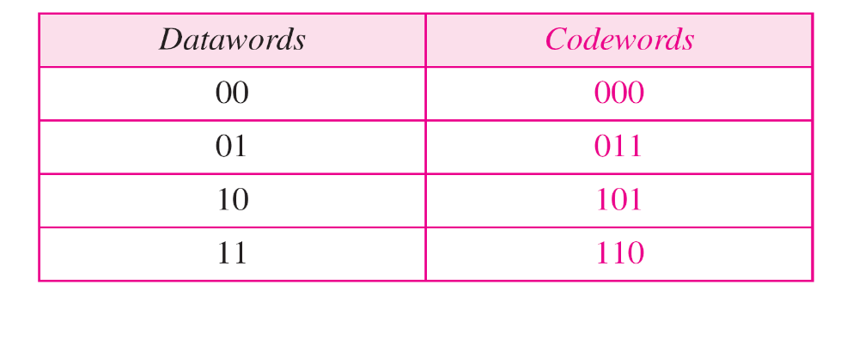
Example 10.10
1. The scheme in Table 10.1 is a linear block code
because the result of XORing any codeword with any
other codeword is a valid codeword. For example, the
XORing of the second and third codewords creates the
fourth one.
10.

Slide 19
Example 10.11
In our first code the numbers of 1s in the nonzero codewords are 2, 2, and 2. So the minimum Hamming distance is d_{min} = 2. In our second code , the numbers of 1s in the nonzero codewords are 3, 3, and 4. So in this code we have d_{min} = 3.
10.

Slide 20
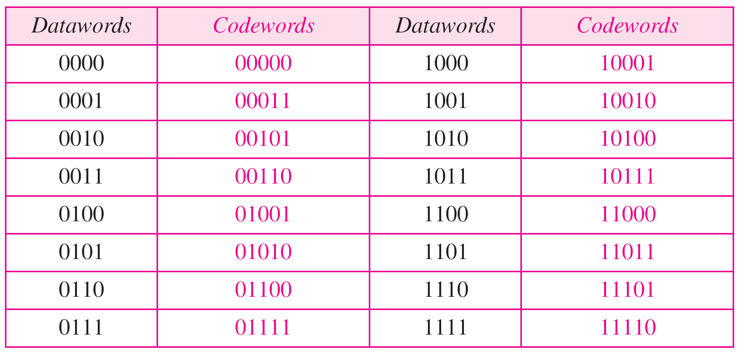
Table 10.3 Simple parity-check code C(5, 4)
r0=a3+a2+a1+a0(mod 2)
s0=b3+b2+b1+b0+q0(mod 2)
10.

Slide 21

Figure 10.10 Encoder and decoder for simple parity-check code
10.

Slide 22
Example 10.12
Let us look at some transmission scenarios. Assume the sender sends the dataword 1011. The codeword created from this dataword is 10111, which is sent to the receiver. We examine five cases:
1. No error occurs; the received codeword is 10111. The
syndrome is 0. The dataword 1011 is created.
2. One single-bit error changes a₁ . The received
codeword is 10011. The syndrome is 1. No dataword
is created.
3. One single-bit error changes r₀ . The received codeword
is 10110. The syndrome is 1. No dataword is created.
10.

Slide 23
Example 10.12 (continued)
4. An error changes r₀ and a second error changes a₃ .
The received codeword is 00110. The syndrome is 0.
The dataword 0011 is created at the receiver. Note that
here the dataword is wrongly created due to the
syndrome value.
5. Three bits—a₃, a₂, and a₁—are changed by errors.
The received codeword is 01011. The syndrome is 1.
The dataword is not created. This shows that the simple
parity check, guaranteed to detect one single error, can
also find any odd number of errors.
10.

Slide 24
Note
A simple parity-check code can detect an odd number of errors.
10.

Slide 25

Figure 10.11 Two-dimensional parity-check code
10.

Slide 26

Figure 10.11 Two-dimensional parity-check code
10.

Slide 27

Figure 10.11 Two-dimensional parity-check code
10.

Slide 28
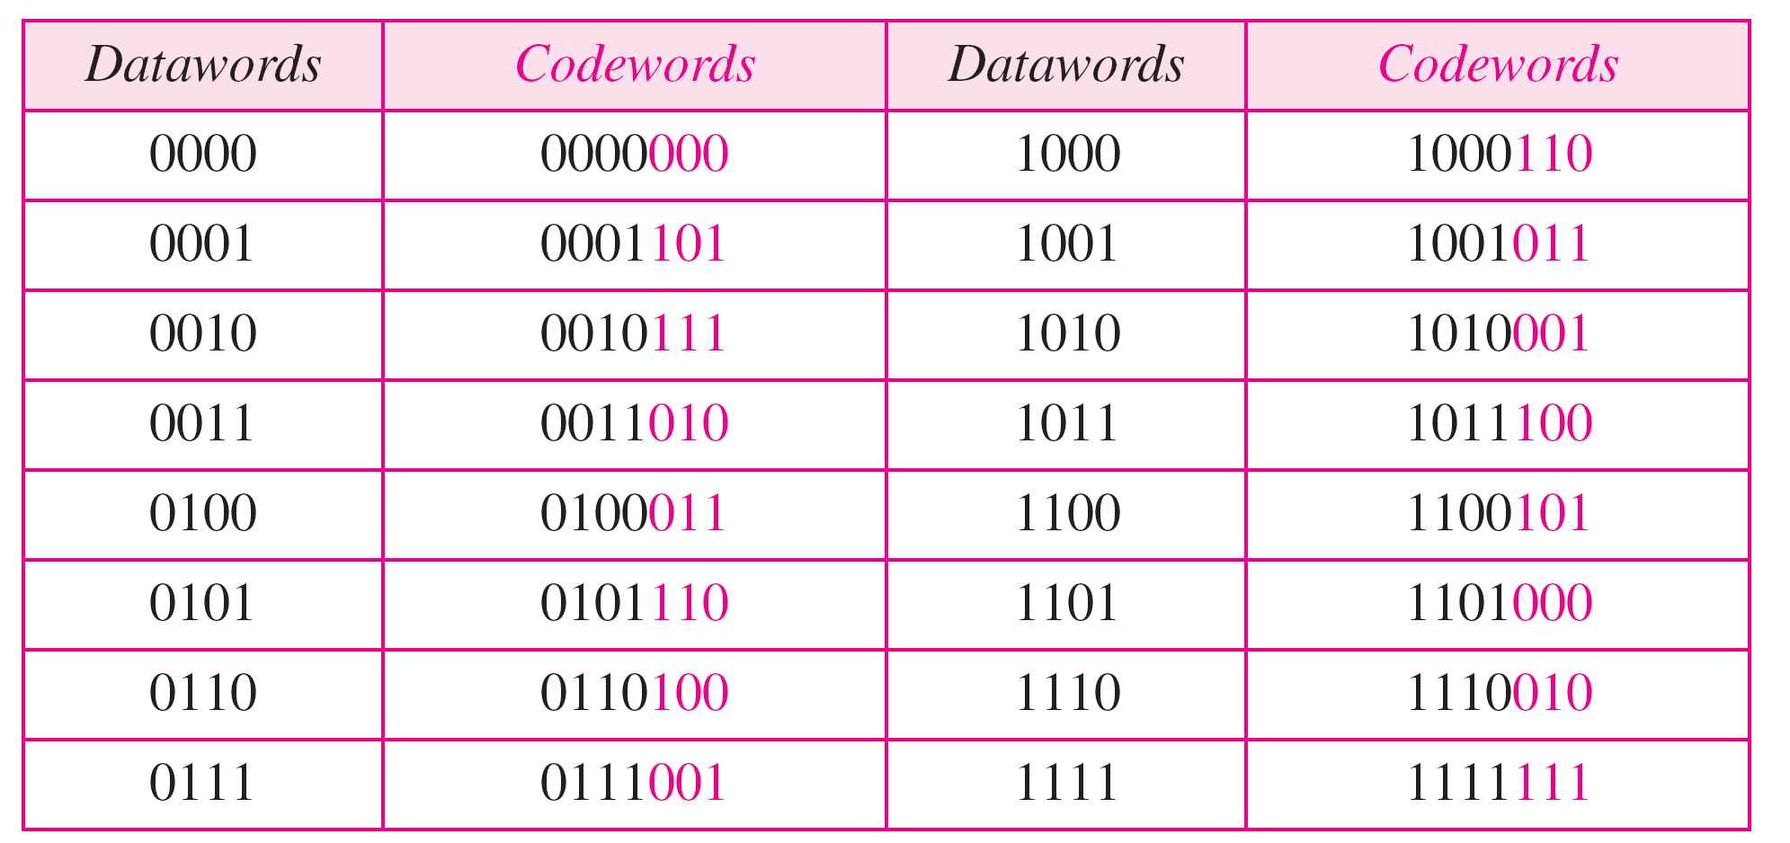
Table 10.4 Hamming code C(7, 4) - n=7, k = 4
10.

Slide 29
Calculating the parity bits at the transmitter
:
Modulo 2 arithmetic:
r0 = a2 + a1 + a0
r1 = a3 + a2 + a1
r2 = a1 + a0 + a3
Calculating the syndrome at the receiver:
s0 = b2 + b1 + b0 +q0
s1 = b3 + b2 +b1+q1
s2 = b1 + b0 + b3+q2
10.

Slide 30
Logical decision made by the correction logic analyzer a/the decoder
s0 = b2 + b1 + b0 +q0
s1 = b3 + b2 +b1+q1
s2 = b1 + b0 + b3+q2
Syndrome 000 001 010 011 100 101 110 111
Error None q0 ql b2 q2 bo b3 bl
if qo is in error, So is the only bit affected; the syndrome, therefore, is 001.
If b2 is in error, So and s1 are the bits affected; the syndrome, therefore is 011.
Similarly, if b1 is in error, all 3 syndrome bits are affected and the syndrome is 111

Slide 31

Figure 10.12 The structure of the encoder and decoder for a Hamming code
10.

Slide 32
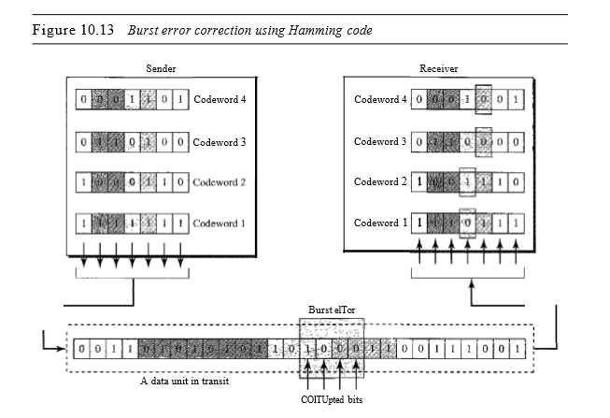
Performance
A Hamming code can only correct a single error or detect a double error.
There is a way to make it detect a burst error.
The key is to split a burst error between several codewords, one error for each codeword.
4. Burst error of size 4 corrupts the frame, only 1bit from each codeword is corrupted.
5. The corrupted bit in each codeword can then easily be corrected at the receiver

Slide 33
10-4 CYCLIC CODES
Cyclic codes are special linear block codes with one extra property. In a cyclic code, if a codeword is cyclically shifted (rotated), the result is another codeword.
Topics discussed in this section:
Cyclic Redundancy Check
Hardware Implementation
Polynomials
Cyclic Code Analysis
Advantages of Cyclic Codes
Other Cyclic Codes
10.

Slide 34

Table 10.6 A CRC code with C(7, 4)

Slide 35

Figure 10.14 CRC encoder and decoder
10.

Slide 36

Figure 10.15 Division in CRC encoder
10.

Slide 37

Figure 10.16 Division in the CRC decoder for two cases
10.

Slide 38

Figure 10.17 Hardwired design of the divisor in CRC
10.

Slide 39

Figure 10.18 Simulation of division in CRC encoder
10.

Slide 40
Figure 10.19 The CRC encoder design using shift registers
10.

Slide 41

Figure 10.20 General design of encoder and decoder of a CRC code
10.

Slide 42
Using Polynomials
We can use a polynomial to represent a binary word.
Each bit from right to left is mapped onto a power term.
The rightmost bit represents the “0” power term. The bit next to it the “1” power term, etc.
If the bit is of value zero, the power term is deleted from the expression.

Slide 43

Figure 10.21 A polynomial to represent a binary word
10.

Slide 44

Figure 10.22 CRC division using polynomials
10.

Slide 45
Note
The divisor in a cyclic code is normally called the generator polynomial
or simply the generator.
10.

Slide 46
Note
In a cyclic code,
If s(x) ≠ 0, one or more bits is corrupted.
If s(x) = 0, either
a. No bit is corrupted. or
b. Some bits are corrupted, but the
decoder failed to detect them.
10.

Slide 47
Note
In a cyclic code, those e(x) errors that are divisible by g(x) are not caught.
Received codeword (c(x) + e(x))/g(x) =
c(x)/g(x) + e(x)/gx
The first part is by definition divisible the second part will determine the error. If “0” conclusion -> no error occurred. Note: that could mean that an error went undetected.
10.

Slide 48

Figure 10.23 Representation of two isolated single-bit errors using polynomials
10.

Slide 49
Note
If a generator cannot divide x^{t} + 1
(t between 0 and n – 1),
then all isolated double errors
can be detected.
10.

Slide 50
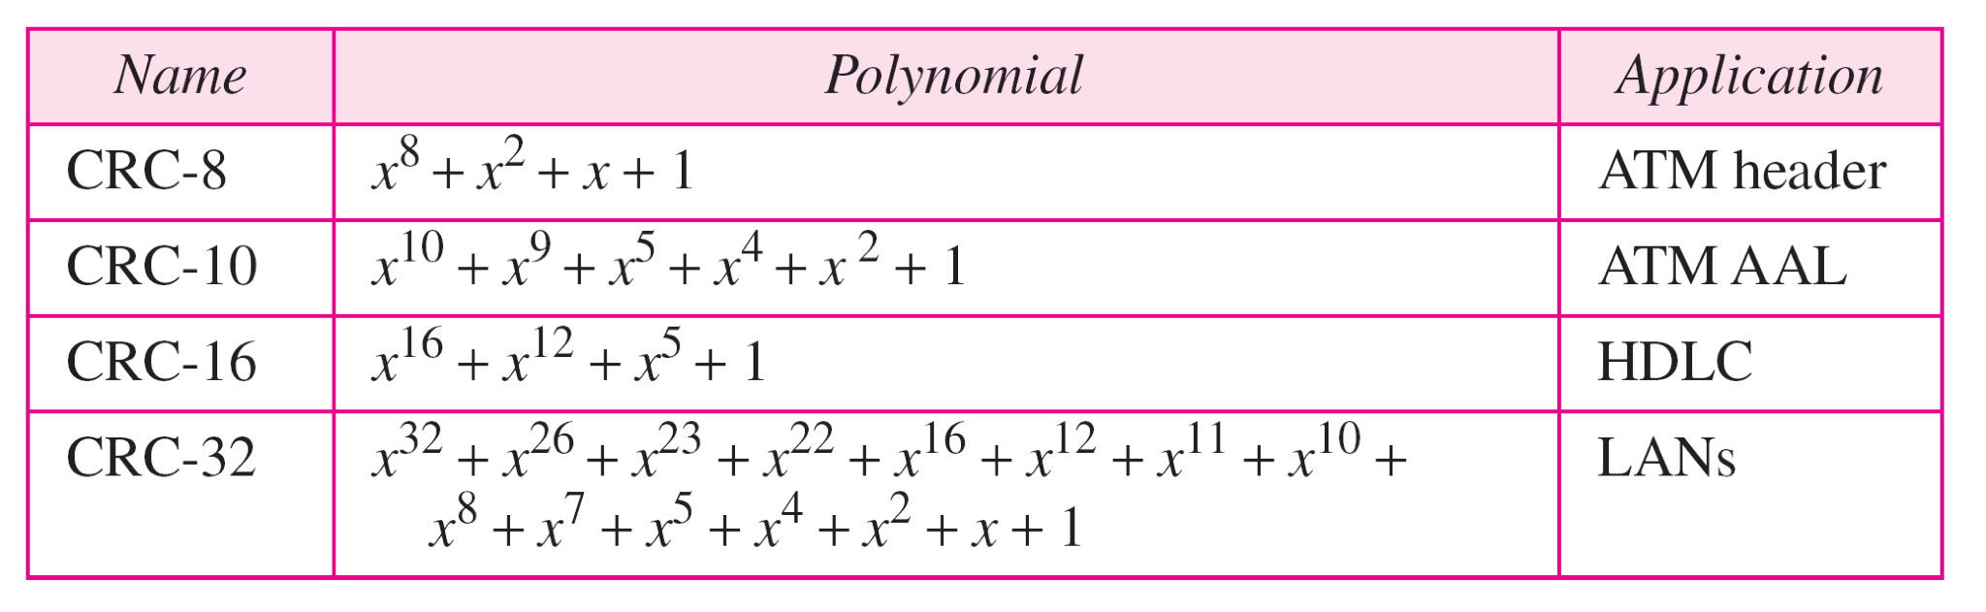
Table 10.7 Standard polynomials
10.

Slide 51
10-5 CHECKSUM
The last error detection method we discuss here is called the checksum. The checksum is used in the Internet by several protocols although not at the data link layer. However, we briefly discuss it here to complete our discussion on error checking
Topics discussed in this section:
Idea
One’s Complement
Internet Checksum
10.

Slide 52
Example 10.18
Suppose our data is a list of five 4-bit numbers that we want to send to a destination. In addition to sending these numbers, we send the sum of the numbers. For example, if the set of numbers is (7, 11, 12, 0, 6), we send (7, 11, 12, 0, 6, 36), where 36 is the sum of the original numbers. The receiver adds the five numbers and compares the result with the sum. If the two are the same, the receiver assumes no error, accepts the five numbers, and discards the sum. Otherwise, there is an error somewhere and the data are not accepted.
10.

Slide 53
Example 10.19
We can make the job of the receiver easier if we send the negative (complement) of the sum, called the checksum. In this case, we send (7, 11, 12, 0, 6, −36). The receiver can add all the numbers received (including the checksum). If the result is 0, it assumes no error; otherwise, there is an error.
10.

Slide 54
Example 10.20
How can we represent the number 21 in one’s complement arithmetic using only four bits?
Solution
The number 21 in binary is 10101 (it needs five bits). We can wrap the leftmost bit and add it to the four rightmost bits. We have (0101 + 1) = 0110 or 6.
10.

Slide 55
Example 10.21
How can we represent the number −6 in one’s complement arithmetic using only four bits?
Solution
In one’s complement arithmetic, the negative or complement of a number is found by inverting all bits. Positive 6 is 0110; negative 6 is 1001. If we consider only unsigned numbers, this is 9. In other words, the complement of 6 is 9. Another way to find the complement of a number in one’s complement arithmetic is to subtract the number from 2^{n} − 1 (16 − 1 in this case).
10.

Slide 56
Example 10.22
Let us redo Exercise 10.19 using one’s complement arithmetic. Figure 10.24 shows the process at the sender and at the receiver. The sender initializes the checksum to 0 and adds all data items and the checksum (the checksum is considered as one data item and is shown in color). The result is 36. However, 36 cannot be expressed in 4 bits. The extra two bits are wrapped and added with the sum to create the wrapped sum value 6. In the figure, we have shown the details in binary. The sum is then complemented, resulting in the checksum value 9 (15 − 6 = 9). The sender now sends six data items to the receiver including the checksum 9.
10.

Slide 57
Example 10.22 (continued)
The receiver follows the same procedure as the sender. It adds all data items (including the checksum); the result is 45. The sum is wrapped and becomes 15. The wrapped sum is complemented and becomes 0. Since the value of the checksum is 0, this means that the data is not corrupted. The receiver drops the checksum and keeps the other data items. If the checksum is not zero, the entire packet is dropped.
10.

Slide 58

Figure 10.24 Example 10.22
10.

Slide 59
Note
Sender site:
1. The message is divided into 16-bit words.
2. The value of the checksum word is set to 0.
3. All words including the checksum are
added using one’s complement addition.
4. The sum is complemented and becomes the
checksum.
5. The checksum is sent with the data.
10.

Slide 60
Note
Receiver site:
1. The message (including checksum) is
divided into 16-bit words.
2. All words are added using one’s
complement addition.
3. The sum is complemented and becomes the
new checksum.
4. If the value of checksum is 0, the message
is accepted; otherwise, it is rejected.
10.

Slide 61
Example 10.23
Let us calculate the checksum for a text of 8 characters (“Forouzan”). The text needs to be divided into 2-byte (16-bit) words. We use ASCII (see Appendix A) to change each byte to a 2-digit hexadecimal number. For example, F is represented as 0x46 and o is represented as 0x6F. Figure 10.25 shows how the checksum is calculated at the sender and receiver sites. In part a of the figure, the value of partial sum for the first column is 0x36. We keep the rightmost digit (6) and insert the leftmost digit (3) as the carry in the second column. The process is repeated for each column. Note that if there is any corruption, the checksum recalculated by the receiver is not all 0s. We leave this an exercise.
10.

Slide 62

Figure 10.25 Example 10.23
10.

